Slide 1
Drought

Slide 2
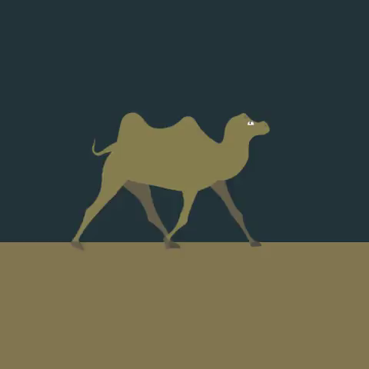
By the end of the lesson, you should be able to:
1. | Identify what a drought is.
2. | Describe some adaptations used by animals to cope with drought.
3. | Describe some adaptations used by plants to cope with drought.

Slide 3
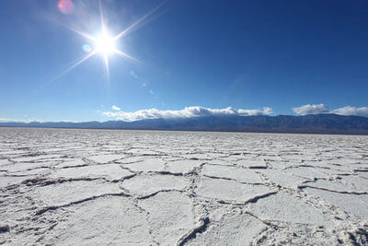
A drought is a period of below average rainfall in a certain area.
It can last anywhere from a month to several years. If it lasts for one year, the area in question receives much less rain than it would in a normal year.
Note that 'arid' means extremely dry. You will seeing this word a lot as we go on!

Slide 4
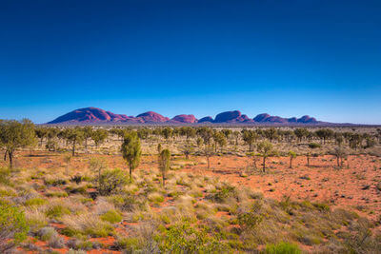
Australia is the driest inhabited continent on Earth, which means there isn't always enough water to go around.
Many parts of Australia were affected by severe droughts between 1996 and 2010. This time was known as the Millennium Drought. Farmland dried up, rivers stopped flowing and billabongs became empty. Some say it was the worst drought in the country's recorded history.

Slide 5
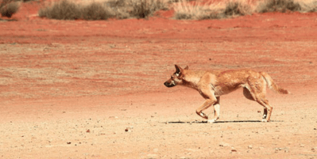
A severe drought can impact people as well as natural ecosystems. In times of hardship, we should all do our bit to conserve water.

Slide 6
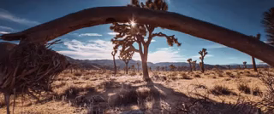
There are obvious negative effects of drought on ecosystems.
Without rain water, plants cannot grow and the consumers that depend on them for energy often die.

Slide 7


Slide 8
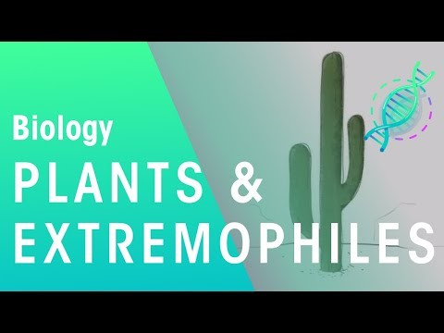

Slide 9
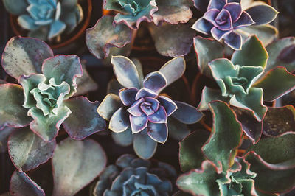
In order to survive a drought, plants and animals need to be adapted for conserving water.
Organisms that cannot do this are likely to die of thirst or heatstroke.

Slide 10
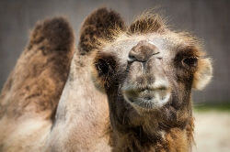
Many animals in drought-prone areas have developed a useful physiological adaptation - concentrated urine.
Urine contains waste products, such as urea, dissolved in water. If it is very concentrated, that means there is little water in the urine. Animals that produce it waste very little water in excretion, so they have more water stored in their bodies to outlast dry conditions.

Slide 11
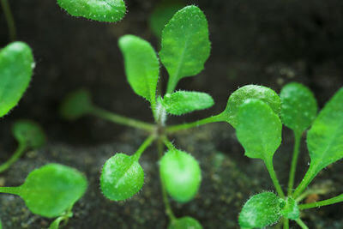
Drought prone environments change how organisms behave in order to survive.
Mouse-ear cress (Arabidopsis thaliana) is an example of an ephemeral plant. This means it is only active for a short period of the year - the wet season. For the rest of the year, the plant exists as dormant seeds that can outlast month-long droughts.
Being ephemeral is an example of a behavioural adaptation to arid conditions.

